Slide 1
The 1st Step
In the Journey of A Thousand Miles
2016
Lima, Peru

Slide 2
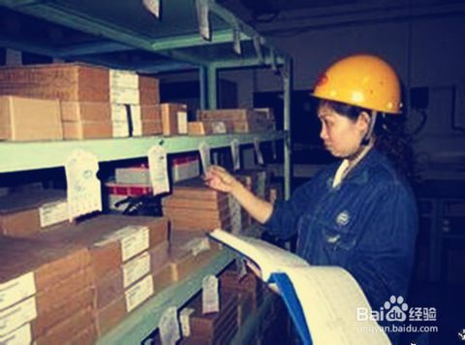
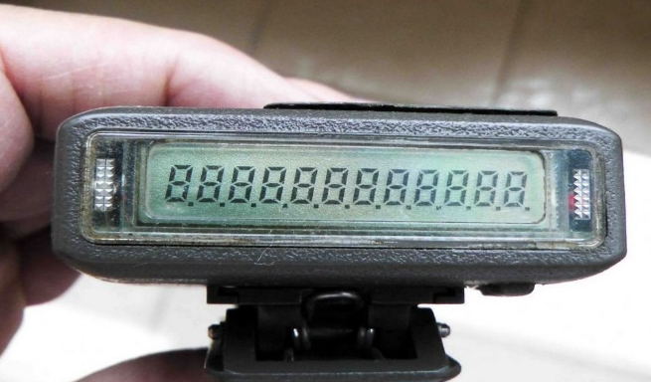
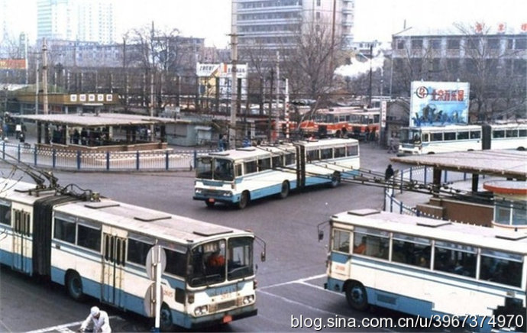
Life in 1990s
China in 1990s
Small Business Runs On These
Green Trains
BP Calls
Trolley Cars

Slide 3
Mr. & Mrs. Cha
100 % Small, Online But International Business
Mr. Cha
From 2 people to 80 employees
From 3 t0 200+ countries
From 0 to million dollars revenues
From reselling to own brands
Mr. Cha and Mrs. Cha - Founders of Baby Online Dress Brand
Mrs. Cha

Slide 4
The Driving Force of China’s Economy
In 2013, China became the largest e-commerce market in the world
By 2015, the market size of China’s e-commerce reached 16.2 trillion RMB, approximately 2.4 trillion USD .
60 Million
SMEs
10 Million SMEs
5 Million SMEs
the 2nd Largest Economy in the World
the Largest E-Commerce Market in the World
To Be Continued…

Slide 5
China Cross Border E-Commerce for Import
CHINA
900 Billion RMB (132 Billion USD) in 2015
1.2 Trillion RMB (176 Billion USD) in 2016
1.9 Trillion RMB (279 Billion USD) in 2018
Increase Rate over 38% YoY
Middle Class Size up to 200 Million Families
Looking for Higher Quality & Lower Price

Slide 6
Key Issues to Address
1. Lack of Market Intelligence
They lack an understanding of the potential market and future opportunities offered by e-commerce
2. Lack of Capacity Building
They lack capacity building resources, to increase touch points with small business owners so as to improve their capability to master e-commerce.

Slide 7
China Import Market via E-Commerce
WHO
Who Are Buying ?
WHO
HOW
How Are They Buying ?
Why Are They Buying ?
WHY
WHERE
Where Do They Buy ?
What Are They Buying ?
WHAT
WHEN
What Frequency Are They Buying At ?

Slide 8
Who Are Buying?
Buyers Profile
01
02
64.8% Male
35.2% Female
74.7%
between 26 and 40
04
03
66.5%
1 Kid or More
74.6%
College Degree

Slide 9
Why Are They Buying?
High Product Quality
60.7%
45.6%
Specific Brands
52%
42.8%
Cheaper
Price
58.6%
Product Unavailability Domestically
Richer Product Variety
Notes:
60.7% of them buying for high product quality;
58.6% of them buying for cheaper prices;
52% of them buying due to products’ unavailability in domestic markets;
45.6% of them for specific brands;
42.8% of them for richer product variety;

Slide 10
What Are They Buying?
45.7%
39.3%
38.6%
38.0%
30.6%
Beauty & Cosmetics
Baby Products
Food & Health Care
Fashion & Clothing
Consumer Electronics
26.6%
26.1%
26.0%
24.4%
23.1%
Home & Garden
Handbags
Outdoors & Sports
Home Electronics
Toys
Notes:
45.7 % of them buy beauty and cosmetics;
39.3% baby products;
38.6% for food and health care;
38% for fashion and clothing;
30.6% for consumer electronics;
26.6% for home and garden;
26.1% for handbags;
26% for outdoors and sports;
24.4% for home electronics;
23.1% for toys.

Slide 11
How Are They Buying ? – Channel
Social
Media
39.8%
27.3%
Media Exposure
59.8%
51.2%
36.1%
Friends & Family
Online
Advertisements
Shopping Guide Websites
Notes:
59.8% from shopping guide websites;
51.2% of them buying from friends and family recommendations;
47.3% from searching online;
39.8% from social media;
36.1% from online advertisement;
27.3% from media exposure

Slide 12
How Are They Buying ? – Payments
71.8%
3rd Party Payment
52.5%
Online Transfer
55.7%
Credit Cards
15.9%
16%
Wire Transfer
20.2%
Bank Transfer
Online Financing
70+%
AVERAGE
USE Third Party Payment Platforms
Notes:
71.8% from 3rd party payment platforms;
55.7% from credit cards;
52.5% from online transfer;
20.2% use bank transfer;
16% use wire transfer;
15.9% from online financing services

Slide 13
How Are They Buying ? – Logistics
Domestic
Express Service
International
Express Service
54.8%
57.2%
36.6%
Transfer
Warehouse Service
Postal Service
54.5%
Notes:
57.2% from domestic express services;
54.8% from international express services;
54.5% from postal services;
36.6% from transfer warehouse services

Slide 14
Where Are They Buying?
53.9%
USA
28%
Australia
19.6%
France
45.7%
Japan
20.4%
UK
28.5%
Germany
20.4%
NZ
35.3%
Korea
Notes:
53.9% from the USA;
45.7% from Japan;
35.3% from Korea;
28.5% from Germany;
28% from Australia;
20.4% from UK;
20.4% from New Zealand;
19.6% from France

Slide 15
When Are They Buying ?
Once A Quarter or More
48.7%
Every Single Month
34.8%
Purchasing Frequency
16.5%
Every Half Year
Notes:
34.8% of them purchase every single month;
48.7% of them purchase at least once a quarter;
16.5% of them only purchase every half year

Slide 16
Lack of Capacity Building
74%
82%
48%
89%
74% indicate that cross border e-commerce will be the key disruptive force
82% believe it would also have a great impact on themselves
48% will put cross border e-commerce as a higher priority for their business
89% say lack of awareness of market opportunities and capacity building is the major problem

Slide 17
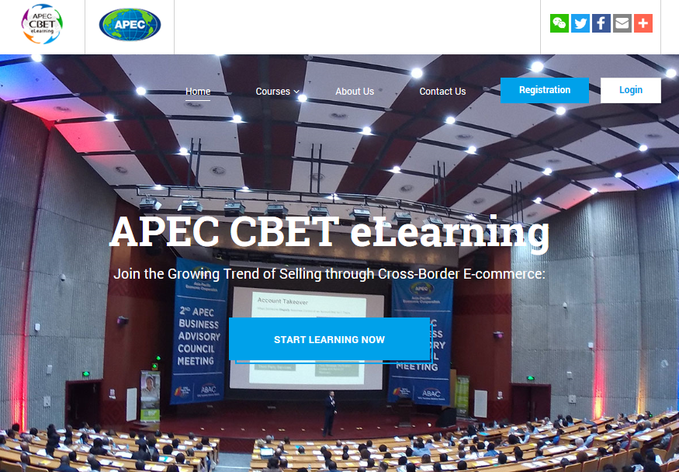
APEC CBET Program
What is CBET?
CBET stands for Cross Border E-Commerce Training, aiming to empower SMEs with needed knowledge and skills to leverage cross border e-commerce to go global.
Ecosystem
Industry Value Chains
Best Practice
Case Studies
Hands-on Operations

Slide 18
联系我们
Contact Us
A Journey of A Thousand Miles Begins Here…
公司总部
地址：在此录入上述图表的描述说明，在此录入上述图表的描述说明
ADD:HOUSE# 01, SUITE A, ROAD# 123, SHANGHAI, 200000
PHONE: +123 456 7890 FAX: +123 456 7890
EMAIL: EMAILID@DOMAIN.COM
上海分公司
地址：在此录入上述图表的描述说明，在此录入上述图表的描述说明
PHONE: +123 456 7890 FAX: +123 456 7890
广东分公司
地址：在此录入上述图表的描述说明，在此录入上述图表的描述说明
PHONE: +123 456 7890 FAX: +123 456 7890

Slide 19
THANK YOU
2016

